Slide 1


Building an Spam Mail Detector
Shivam SINGH

Slide 2
Topics to be covered day by day
Day 01 | Day 02 | Day 03
Introduction to Natural Language Processing | Stemming and Lemmatization | Analyzing Text Data with Word Cloud
Understanding Regular Expressions | Converting Word to Vectors with Bag of Words and TF-IDF | Building an End to End Spam Mail Detection Model
Removing Noise from Text Data and Tokenization | Understanding Naïve Bayes Classifier

Slide 3
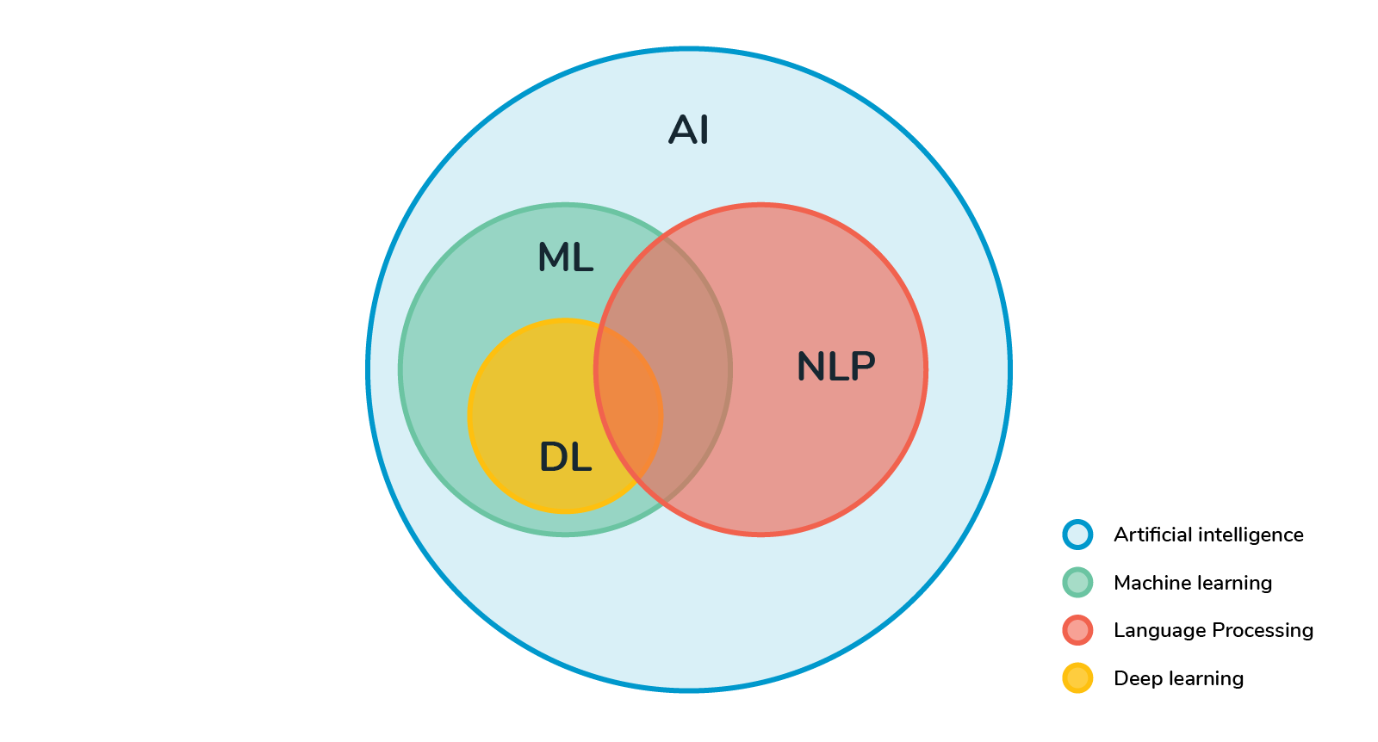
Natural Language Processing
Natural language processing is a subset of Artificial intelligence that helps computers to understand, interpret, and utilize the human languages. NLP allows computers to communicate with peoples using human languages. NLP also provides computers with the ability to read text, hear speech, and try to interpret it.

Slide 4
NLP: Real World Applications
NLP breaks down language into shorter, more basic pieces, called tokens(period, words, etc.), and attempts to understand the relationships of tokens. This approach often uses higher-level NLP features, such as:
Sentiment analysis: It identifies the general mood, or subjective opinions, which is stored in large amount of texts, It is more useful for opinion mining.
Search Autocomplete: help to locate the correct information and answer their questions fastly.
Text-to-Speech and Speech-to-text: It transforms the voice into text and vice a versa.
Chatbot: A computer program that simulates and processes human conversation (either written or spoken), allowing humans to interact with digital devices as if they were communicating with a real person..
Machine Translation: Translates the text or speech of one language into another language.

Slide 5
Regular Expression
Regular expression is a set of characters, called as the pattern, which helps in finding substrings in a given string. The pattern is used to detect the substrings
For example, suppose you have a dataset of customer reviews about your restaurant. Say, you want to extract the emojis from the reviews because they are a good predictor os the sentiment of the review.
Take another example, the artificial assistants such as Siri, Google Now use information retrieval to give you better results. When you ask them for any query or ask them to search for something interesting on the screen, they look for common patterns such as emails, phone numbers, place names, date and time and so on. This is because then the assistant can automatically make a booking or ask you to call the restaurant to make a booking.
Regular expressions are very powerful tool in text processing. It will help you to clean and handle your text in a much better way.

Slide 6
Use Cases of Regular Expression
Validating Email Addresses: Email validation is crucial to ensure that communication with users is possible. A simple RegEx for email validation could be ^[a-zA-Z0-9._%+-]+@[a-zA-Z0-9.-]+\.[a-z A-Z]{2,}$. This checks if the email has the general format of text@text.text.
Cleaning Text Data: Cleaning text data is a common task in Natural Language Processing (NLP). RegEx can be used to remove unwanted characters, such as punctuation. A simple RegEx for this could be [^a-z A-Z ] which matches anything that is not a letter or a space.
Extracting Dates and Times: Dates and times often come in various formats. Regular expressions can be used to extract these from a text. A simple RegEx for a date could be \d{2}/\d{2}/\d{4} which matches a date in the format MM/DD/YYYY.
Validating Password Strength: RegEx can be used to enforce password policies. For example, a RegEx for a strong password could be ^(?=.*[a-z])(?=.*[A-Z])(?=.*\d)[a-z A-Z\d]{8,}$ which requires at least one lowercase letter, one uppercase letter, one digit, and a minimum length of 8 characters.

Slide 7
Stemming and Lemmatization
From Stemming we will process of getting the root form of a word. Root or Stem is the part to which inflectional affixes(like -ed, -ize, etc.) are added. We would create the stem words by removing the prefix or suffix of a word. So, stemming a word may not result in actual words.
As stemming, lemmatization do the same but the only difference is that lemmatization ensures that root word belongs to the language. Because of the use of lemmatization we will get the valid words. In NLTK(Natural language Toolkit), we use WordLemmatizer to get the lemmas of words.
In short, Lemmatization is the best choice when you are looking for qualitative results. In the modern day, Lemmatization algorithms do not affect the performance. But if you want to optimize speed then Stemming algorithms are the best option.

Slide 8
Bag of Words Representation
We need to represent text in a format that you can feed into machine learning algorithms. The most common and popular approach is creating a bag-of-words representation of your text data. The bag-of-words model converts text into fixed-length vectors by counting how many times each word appears.
Limitations of Bag-of-Words:
If we deploy bag-of-words to generate vectors for large documents, the vectors would be of large sizes and would also have too many null values leading to the creation of sparse vectors.
Bag-of-words does not bring in any information on the meaning of the text. For example, if we consider these two sentences – “Text processing is easy but tedious.” and “Text processing is tedious but easy.” – a bag-of-words model would create the same vectors for both of them, even though they have different meanings.

Slide 9
TF-IDF Representation
Term frequency–inverse document frequency, is a numerical statistic that is intended to reflect how important a word is to a document in a collection or corpus. TFIDF works by proportionally increasing the number of times a word appears in the document but is counterbalanced by the number of documents in which it is present. Hence, words like ‘this’, ’are’ etc., that are commonly present in all the documents are not given a very high rank. However, a word that is present too many times in a few of the documents will be given a higher rank as it might be indicative of the context of the document.
End Notes
Bag of Words just creates a set of vectors containing the count of word occurrences in the document (reviews), while the TF-IDF model contains information on the more important words and the less important ones as well.
Bag of Words vectors are easy to interpret. However, TF-IDF usually performs better in machine learning models.

Slide 10
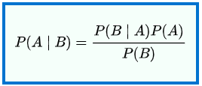
Naïve Bayes Algorithm
In probability theory and statistics, Bayes’s theorem (alternatively Bayes’s law or Bayes’s rule) describes the probability of an event, based on prior knowledge of conditions that might be related to the event. Mathematically, it can be written as:
Where A and B are events and P(B)≠0
P(A|B) is a conditional probability: the likelihood of event A occurring given that B is true.
P(B|A) is also a conditional probability: the likelihood of event B occurring given that A is true.
P(A) and P(B) are the probabilities of observing A and B respectively; they are known as the marginal probability.

Slide 11
When dealing with continuous data, a typical assumption is that the continuous values associated with each class are distributed according to a Gaussian distribution.
Why it is called Naïve Bayes?
The entire algorithm is based on Bayes’s theorem to calculate probability. So, it also carries forward the assumptions for the Bayes’s theorem. But those assumptions(that the features are independent) might not always be true when implemented over a real-world dataset. So, those assumptions are considered Naïve and hence the name.
Why to use naïve bayes for spam filtering?
Naive Bayes assumes independence between features. In text classification, such as spam detection. Only the presence of certain words such as name, place, or any defining words matters, rather than the words such as spam. It doesn’t matter if they occur before or after these informative words and hence will not be considered. Therefore, Naive Bayes often performs well in solving these problems.

Slide 12
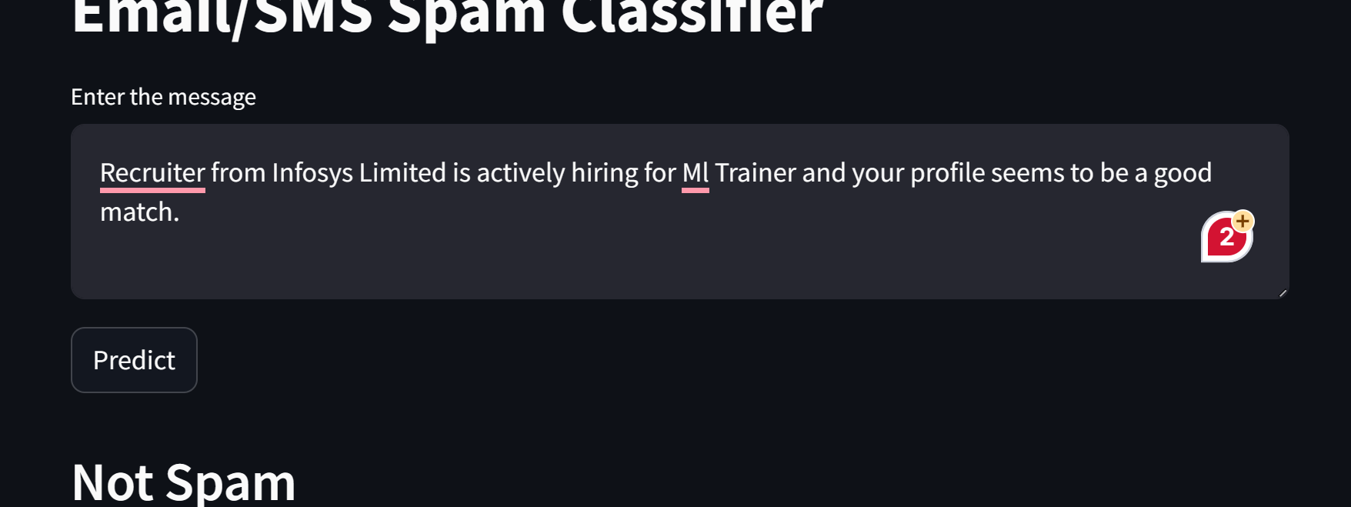
Deployed Final Spam Mail Detector Web Application on Streamlit API

